Slide 1
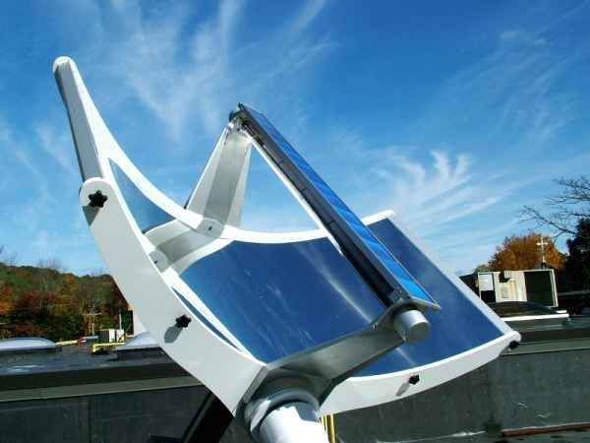
Sunlight to Hydrogen LightFuel ® Hydrogen
Green Hydrogen Investment Opportunity J. Guerra, CEO Lightfuel Co.
LightFuel PEC
cell at focus
of 25X concentrator
2020-9-15 LightFuel Solar-Amplified Electrolysis Copyright 2020 LightFuel Co.

Slide 2
LightFuel ® Hydrogen Who we are
LightFuel is “dba” commercialization vehicle for Nanoptek Corporation’s Solar H2 technology
Founded 2002: Nano Optical Technology for H₂ from sunlight
Offices: Concord, MA U.S.A.; Dr. Chandekar is in Paris, FR
30 U.S. and international patents issued and pending
Funded by NASA, U.S. Dept. of Energy, Quercus Trust
Privately-owned C corporation, incorporated in Delaware
Massachusetts Hydrogen Coalition, founding member
NorthEast Electrochemical Energy Storage, member
Vice President R&D: Dr. Amol Chandekar
Ph.D. Chemistry, R&D Fellow
17 patents issued and pending
Achandekar@nanoptek.com
President and CEO: John M. Guerra P.E.
Optical physicist and entrepreneur
53 patents issued and pending
Jguerra@lightfuelhydrogen.com or Jguerra@nanoptek.com
2020-9-15 LightFuel Solar-Amplified Electrolysis Copyright 2020 LightFuel Co.

Slide 3
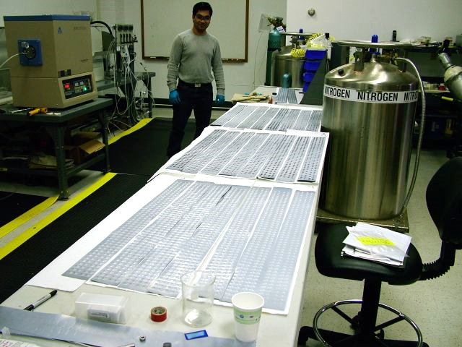
Our Hydrogen Expertise Solar H2 Pioneers since 2002
We have been developing strained photoanodes for efficient production of hydrogen from sunlight since 2002—
Strain-induced bandgap-engineered semiconductor photoanodes
Nano-structure fabrication and other surface modification
Thin and thick film coatings via thermal oxidation, anodizing, vacuum deposition
Light-assisted and zero-bias electrolysis
Photo-Electro-Chemical PEC cells and panels: design, fabrication, testing
Metrology: material characterization of electrolyzer components and systems, including design, testing and optimization
Solar concentrators and solar tracking mounts for electrolysis: design and fabrication
Photoanode production
circa 2009
2020-9-15 LightFuel Solar-Amplified Electrolysis Copyright 2020 LightFuel Co.

Slide 4
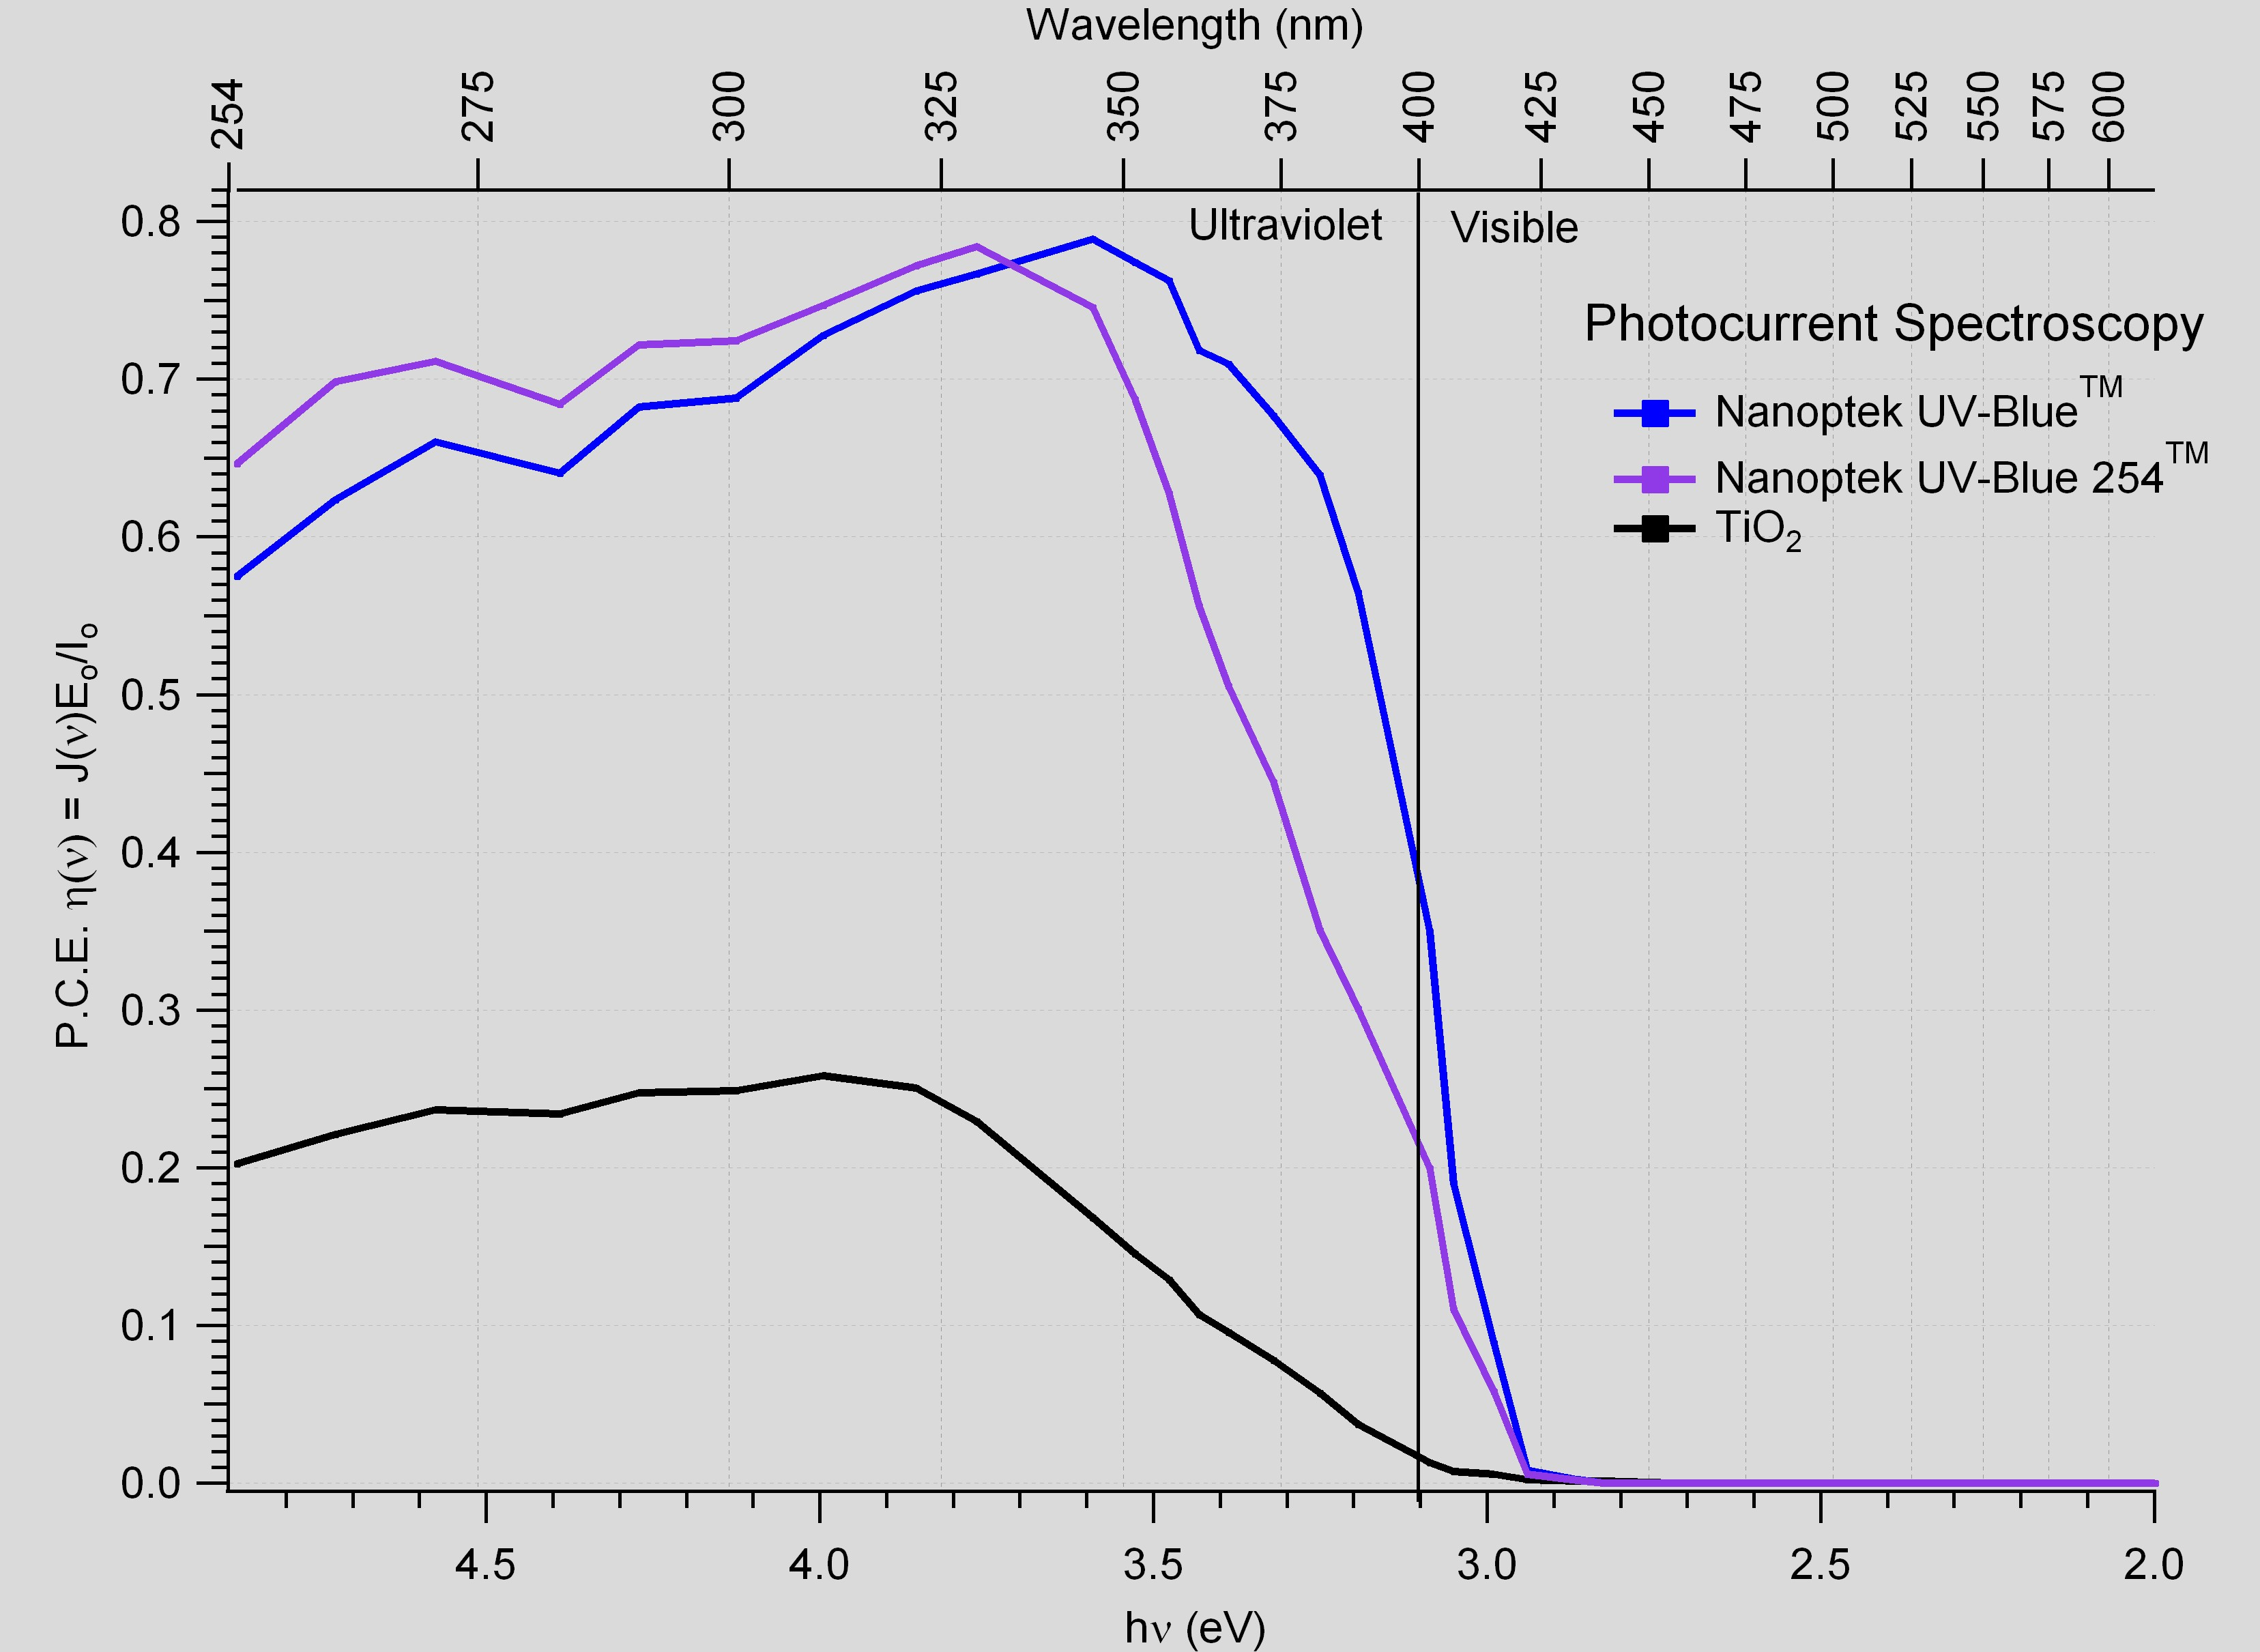
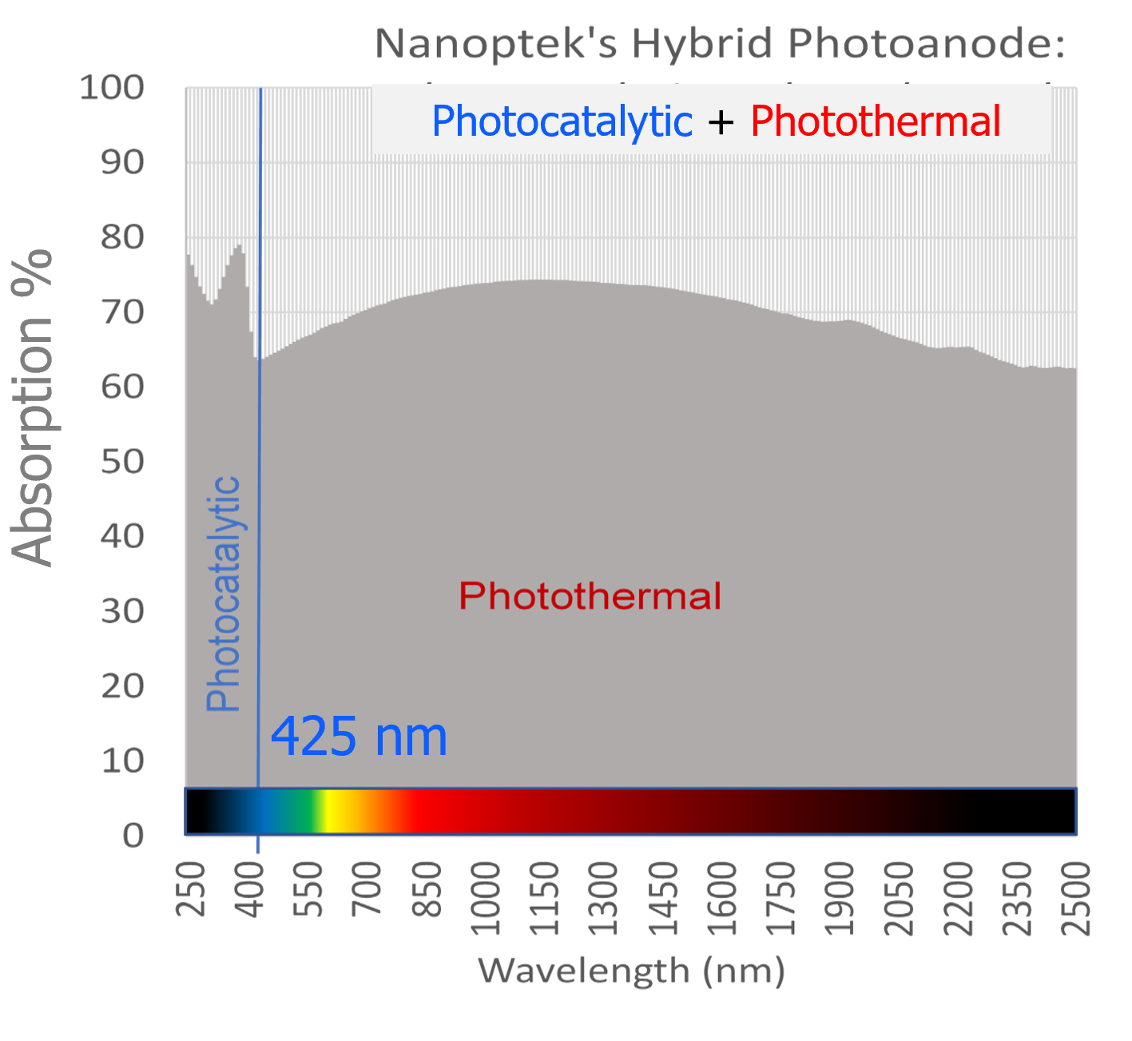
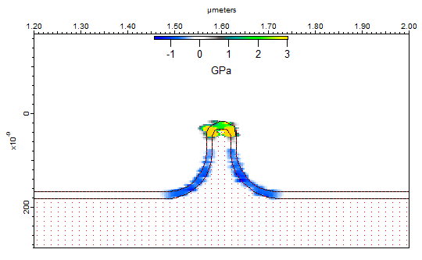
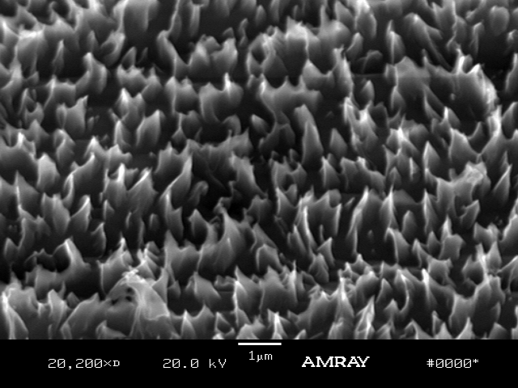
Nanoptek’s Photoanode Strained nano-structured TiO₂

Slide 5
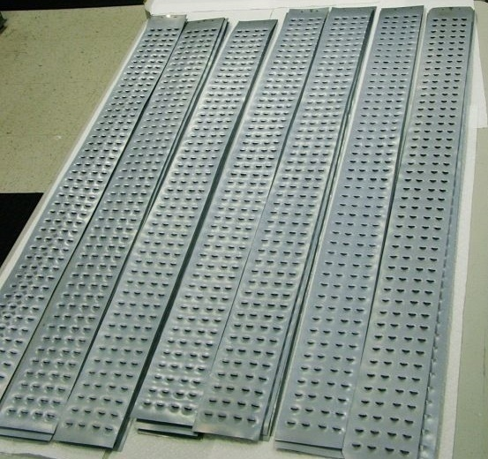
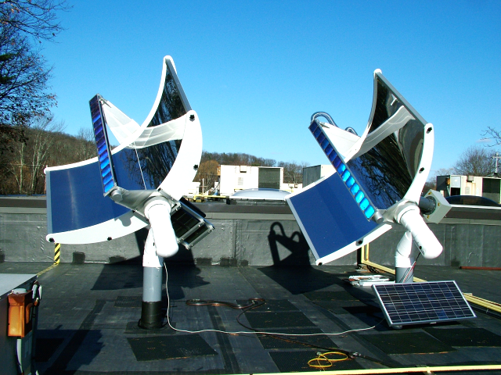
Nanoptek’s Photoanode Manufacture@Scale, Long Life
”At Scale” TT production at “Global Company” of 6,600 photoanodes with area 620m²
No degradation of photoanode performance after 3 years at focus of “25 suns” reflectors

Slide 6
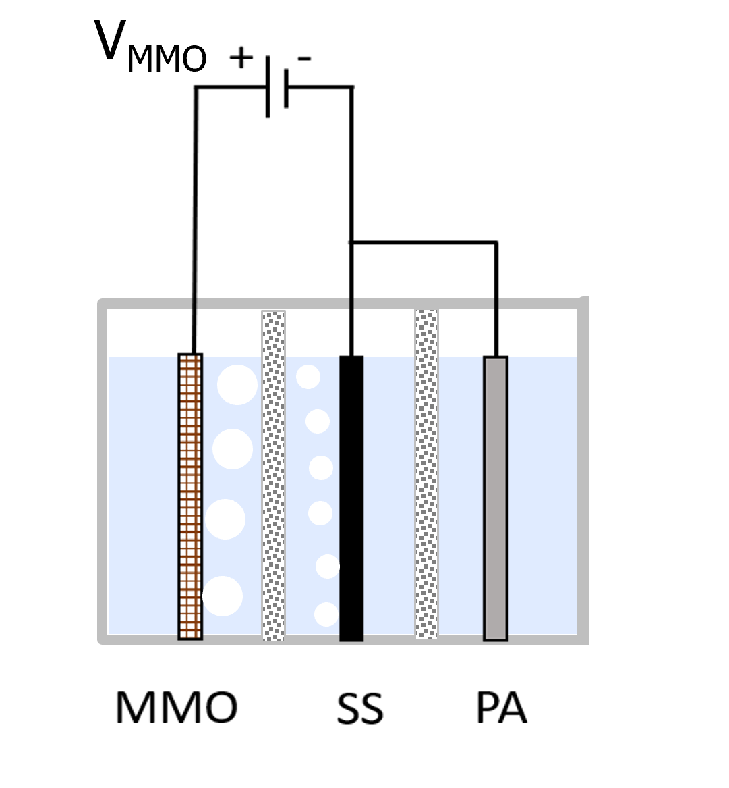
Solar Hybrid Electrolyzer Solar-Amplified electrolysis
V_{Anode}
Electrolyzer
(Alkaline) Cell
I_{H2} =
R_{Cell}
Anode Cathode

Slide 7
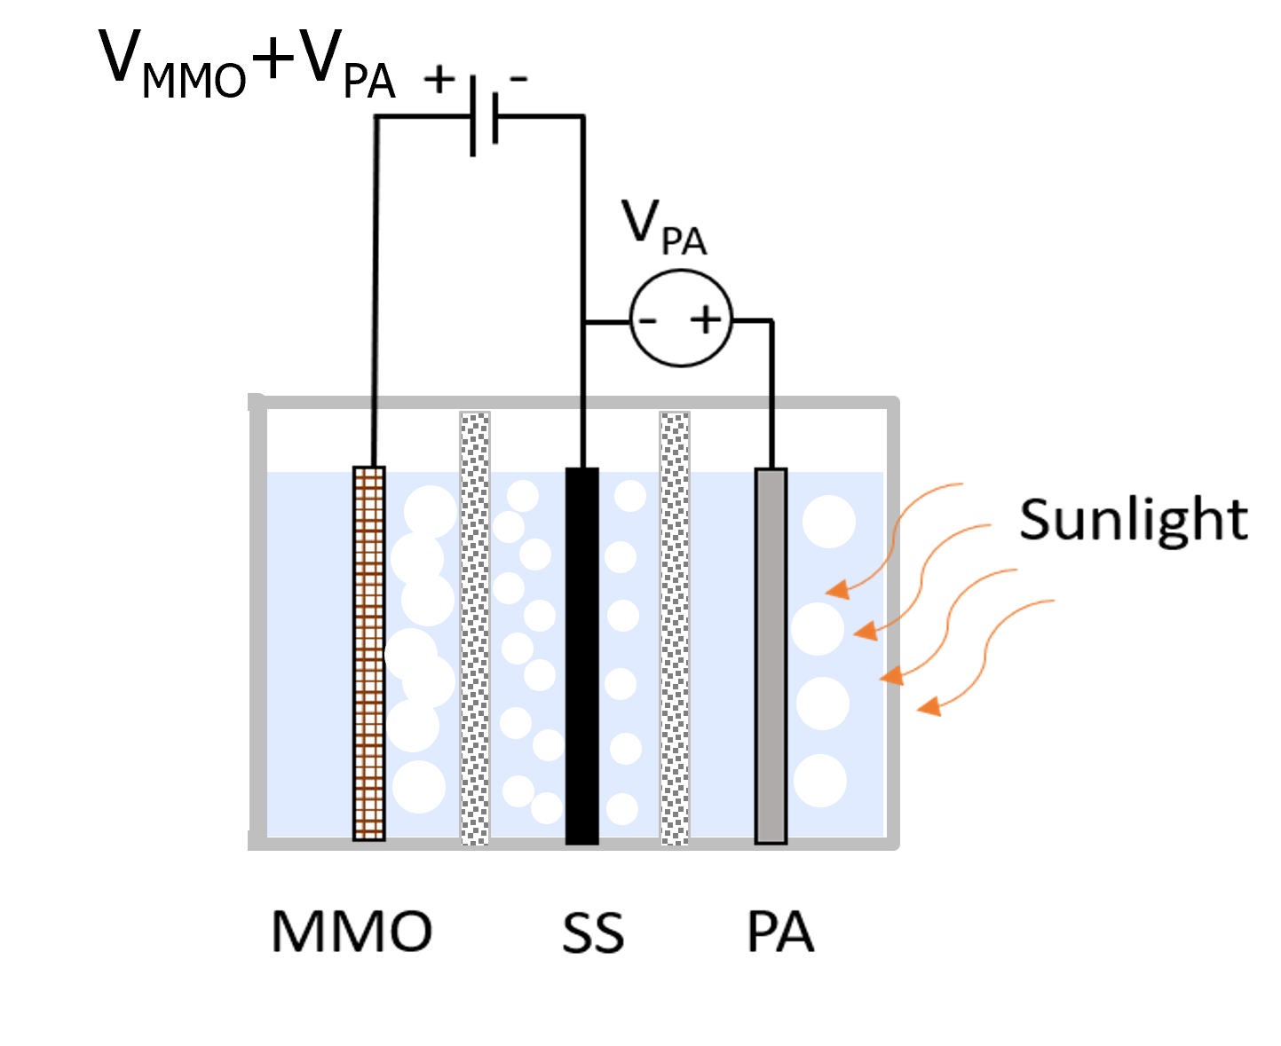
Solar Hybrid Electrolyzer Solar-Amplified electrolysis
V_{PA}+ V_{Anode}
Photo-Electro-Chemical (PEC) Cell
+ Photovoltage
I_{H2} =
V_{MMO}
R_{Cell}
Anode Cathode Photoanode/diode

Slide 8
Solar Hybrid Electrolyzer Solar-Amplified electrolysis
I_{H2} =
V_{PA}+ V_{Anode}
Photo-Electro-Chemical (PEC) Cell
+ Photovoltage +
Photothermal
V_{MMO}
R_{Cell}
Anode Cathode Photoanode/diode

Slide 9
Solar Hybrid Electrolyzer Solar-Amplified electrolysis
I_{H2} =
V_{PA}+ V_{Anode}
Photo-Electro-Chemical (PEC) Cell
+ Photovoltage +
Photothermal
V_{MMO}
R_{Cell}
RESULT
Anode Cathode Photoanode/diode

Slide 10
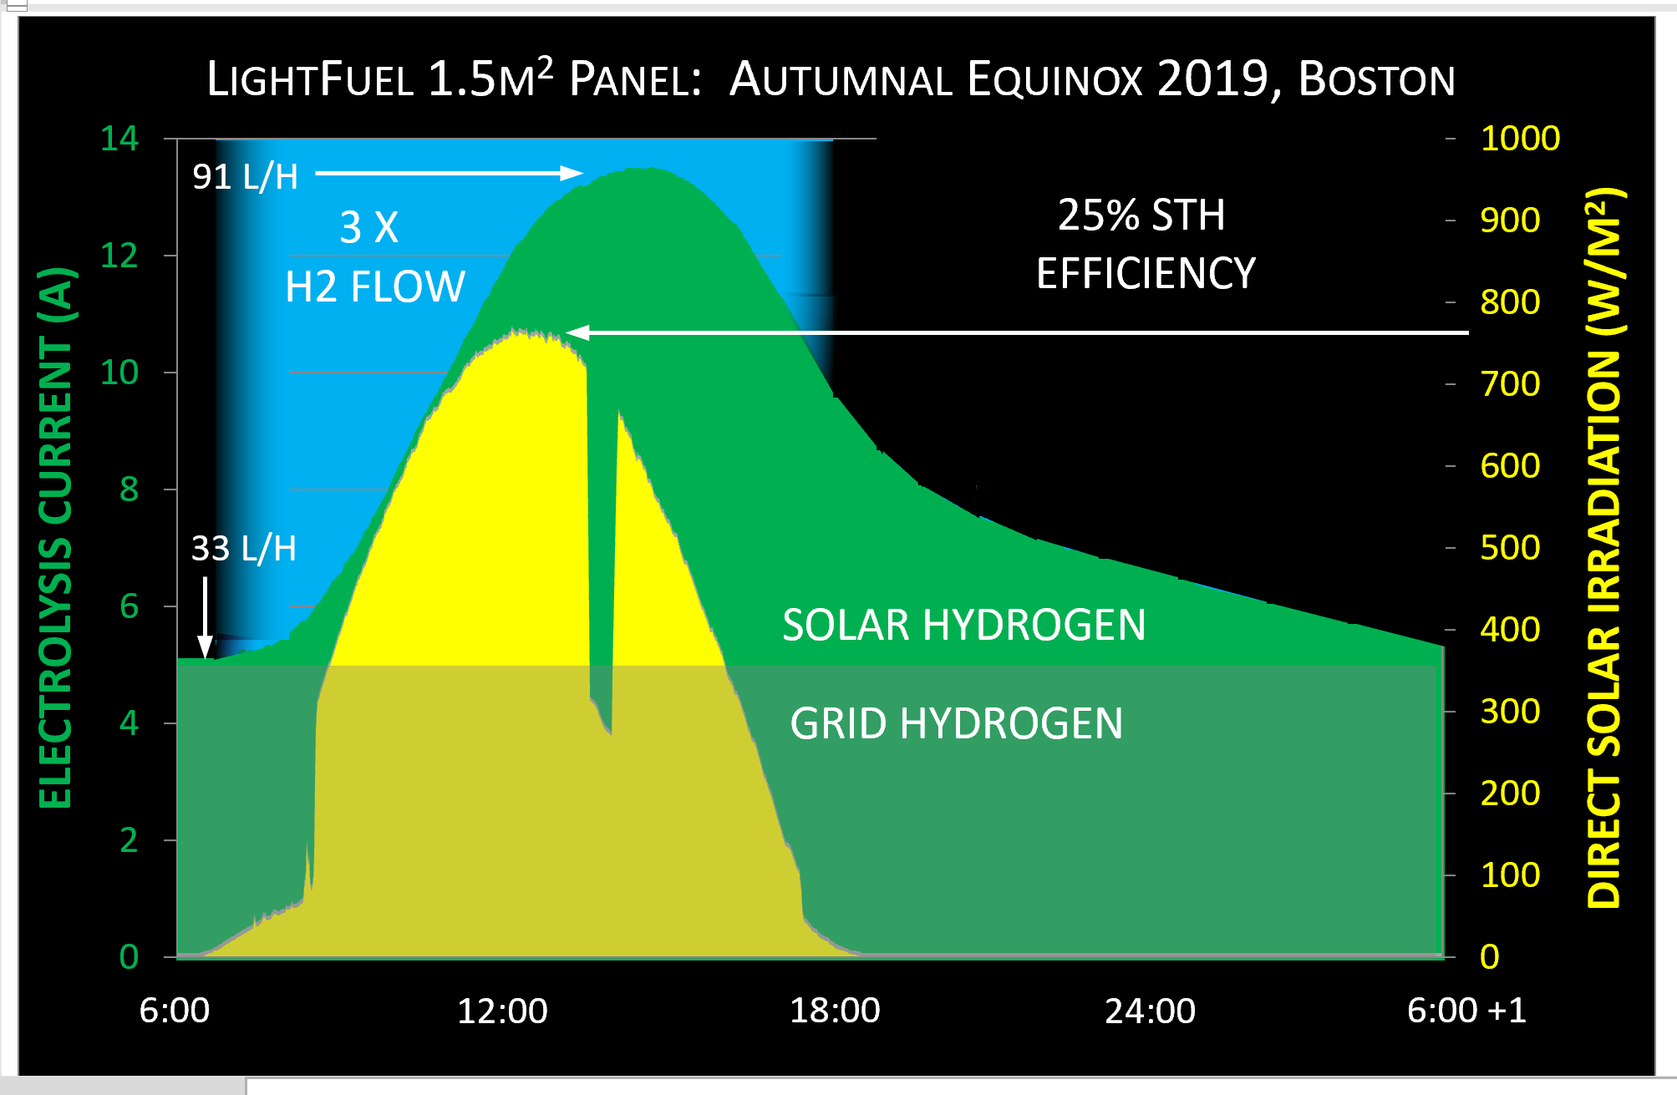
25% Solar-to-Hydrogen World-Record STH Efficiency
ELECTROLYSIS CURRENT (A) PER CELL
2020-2-02 LightFuel Solar-Amplified Electrolysis Copyright 2020 LightFuel Co.

Slide 11
25% Solar-to-Hydrogen Diurnal and Constant Voltage
28% STH Eff. at peak flow
@ 600W/m²
25% STH Eff. diurnal average
2kWh(solar H2)/8kWh sunlight
Panel area is 1.3m²
Solar H2 is 42% of day’s total
2kWh/4.8kWh = 0.42
Solar H2 increases conventional H2 total by 71%
4.8kWh/2.8kWh = 1.71
ELECTROLYSIS CURRENT (A) PER CELL
This diurnal “snapshot” at Constant Voltage (CV) operation on Autumnal Equinox is very close to annual average, so x 365 days = annual total solar hydrogen
2020-2-02 LightFuel Solar-Amplified Electrolysis Copyright 2020 LightFuel Co.

Slide 12
25% Solar-to-Hydrogen Annual and Constant Voltage
475 kWh solar hydrogen annual total HHV energy value
8kWh / 1.3m² LFG panel = 6.15kWh
(730kWh x 4kWh/m2/day Boston and Paris) / 6.15kWh/m2/day = 475 kW
25% STH Eff. annual average
475kWh/(4kWh x 1.3m²x365)=25%
134 Nm³ annual total solar H2
423 Nm³ annual total H2
38 kgs H2 per panel per year
ELECTROLYSIS CURRENT (A) PER CELL
Annual production can be increased by:
— Optimizing operation window daily and seasonally
— Increasing production during peak efficiency hour
The following cost comparison is before optimization….
2020-2-02 LightFuel Solar-Amplified Electrolysis Copyright 2020 LightFuel Co.

Slide 13
H2 Cost:10MW Plant Cap. Yearly avg. @ 4kWh/m²/day
2020-2-02 LightFuel Solar-Amplified Electrolysis Copyright 2020 LightFuel Co.
Notes:
Here we compare th total cost per kilogram of hydrogen between a LightFuel hydrogen plant and a composite Alkaline/PEM hydrogen plant, both with 10MW capacity. A 10MW LightFuel plant will require 37,500 panels or 5.6 hectare (13.8 acres). It should be noted that this large capacity comparison is most favorable to the Alkaline/PEM composite, as the levelized CapEx per kilogram of hydrogen for smaller electrolyzers, such as an 80kW capacity application for onsite distributed hydrogen, increases rapidly for the alkaline/PEM electrolyzer, but is basically the same for Lightfuel solar hydrogen panels. So, here the LightFuel capital cost decreases slightly to $1,544 kW⁻¹ while the alkaline electrolyzer cost decreases by 2.5X to $2,176 kW⁻¹.
The assumptions in this comparison are (1) electricity cost of $0.05/kWh for both, (2) 20 year service lifetime for both, (3) “windowed” operation of the Lightfuel panels with variable voltage V.V., and (4) an annual or yearly average solar direct irradiation of 4kWh/m²/day.
This last point is important. While 4kWh/m²/day is the yearly average for Boston, Paris, and many other parts of the world, considerably higher averages, as much as 8kWh/m²/day, are experienced in the American Southwest, Sub-Saharan Africa, Australia, the Middle East, and other areas. So Lightfuel installations in such solar-rich areas will yield a total cost per kilogram of hydrogen of almost half that presented in this graph, or less than $1.00/kg.
The references below¹ compare the capital cost of electrolyzers per consumed kW capacity. For a 10 MW capacity electrolyzer, having production capacity 2,000 NM³ at 70% electrolysis efficiency, they project a capital cost in 2030 of $800 kW⁻¹ for alkaline electrolyzers and $850 to $1584 kW⁻¹ for PEM electrolyzers. In 2020, the capital cost for a 10 MW alkaline electrolyzer is $900 to $1350 kW⁻¹ and $1050 to $1980 kW⁻¹ for PEM electrolyzers. We find their values to be on the low side from real-world quotes.
O. Schmidt et al, “Future cost and performance of water electrolysis: An expert elicitation study,” International Journal of Hydrogen Energy, 42 (2017) 30470-30492
G. Saur, “Wind-to-Hydrogen Project: Electrolyzer Capital Cost Study,” Technical Report NREL/TP-550-44103, December 2008. Table 2.

Slide 14
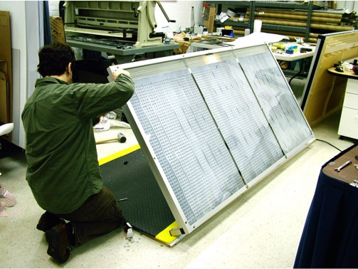
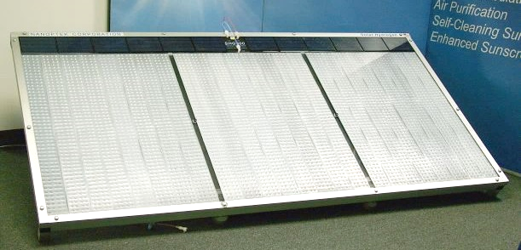
PEC 2m² Panel in 2012 Light-amplified Electrolysis
V_{MMO}
Preparing LightFuel PEC panel for ARPA-E Technology Showcase (invited, 2012).
1.0 m
2.0 m
2020-9-15 LightFuel Solar-Amplified Electrolysis Copyright 2020 LightFuel Co.

Slide 15
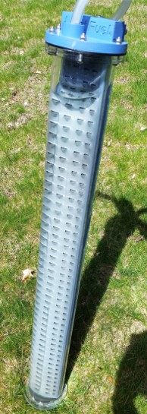
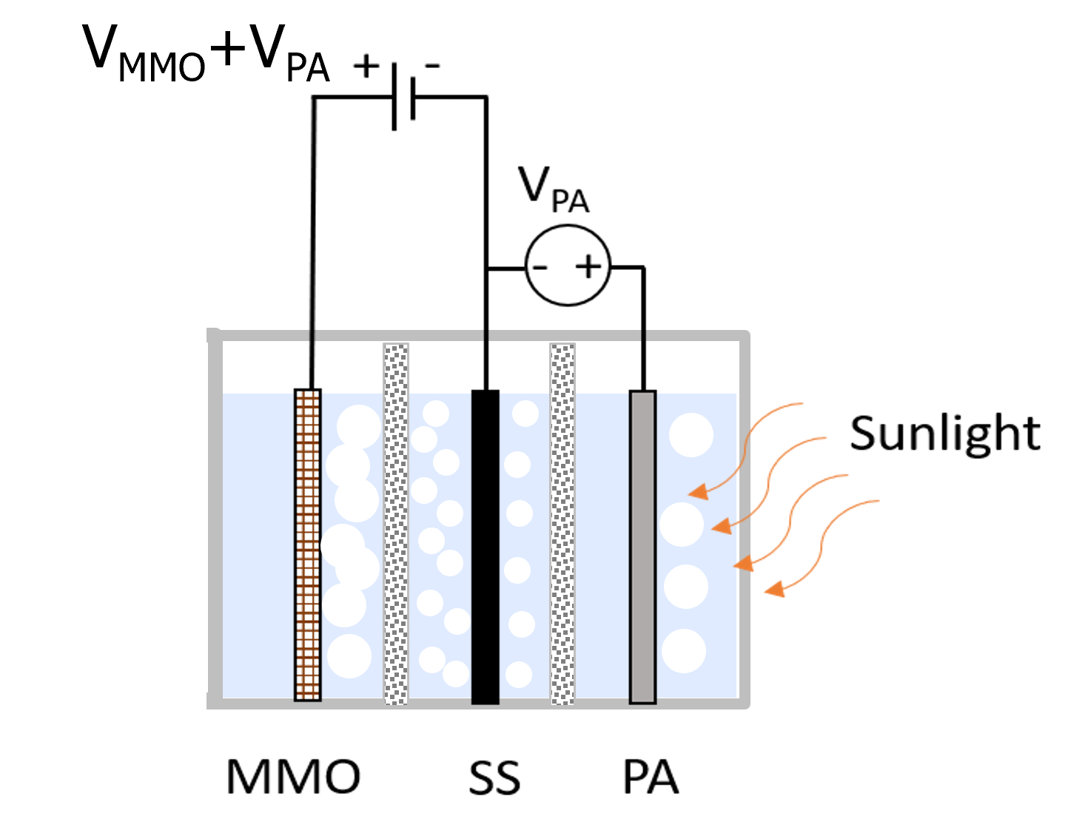
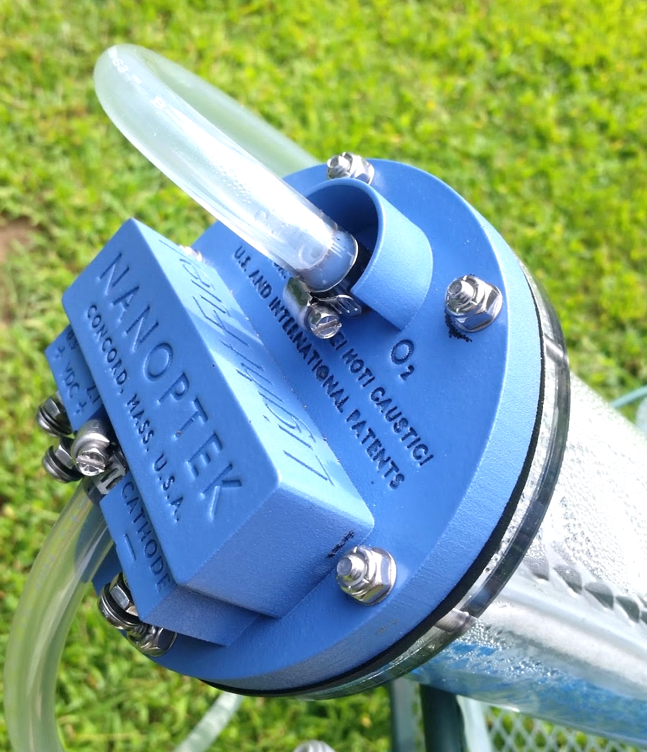
PEC Cell and Panel, 2020 Light-amplified Electrolysis
2020-9-15 LightFuel Solar-Amplified Electrolysis Copyright 2020 LightFuel Co.

Slide 16
Electrical Power Storage 96% Round-Trip Efficiency
On-demand
0.96 MW OUT time-shifted
Power
Interface
Unit
Fuel Cell
60% eff.
Hydrogen Storage
H₂O
H₂
Excess Solar,
1.0 MW IN
Wind, Off-peak grid
SMPS
LightFuel® Array
1 MW→1.6 MW hydrogen hhv
on diurnal basis
96% R-T electrical efficiency in sunlight cost to store≤$0.08/kWh
2020-2-02 LightFuel Solar-Amplified Electrolysis Copyright 2020 LightFuel Co.

Slide 17
Addressable Markets New-to-Disruptive
Application | Market / Business Unit | LightFuel Advantages | Competitive Strength
Ultra-distributed H2, planned residential development (PRD) shared H2 filling station | Mobility / New Business (personal transportation) | Safe, quiet, 6 panels (9 m2) produce 1 kg/day for 70 mpgge, shared cost of compressor/dispenser | Disruptive, new market; neither SMR or conventional electrolyzers can compete on either price or carbon footprint
Interstate highway filling stations | Mobility / New Business (trucking and personal transportation) | Panels connect to scale, use RoW land to and after station, lowest-cost H2/kg | Very high: Beats PV to electrolyzers on both cost and on carbon footprint, land use is taken off table
Employer H2 station | Mobility / New Business (employee benefit) | Panels mount on roof, low cost green H2 fuel, | New market, lower cost and greener H2 than conventional electrolyzers, small scale SMR can’t compete
Warehouse/Factory and Airports | Mobility / New Business (Material handling: forklifts, airport tarmac vehicles) | Panels mount on roof (acres available), onsite H2 for material handling and more | Wins competition by CapEx and OpEx cost with electrolyzers; SMR can’t compete at this scale
Industrial scale onsite H2 feedstock | Industrial H2 / Internal (chemical production, semiconductor manufacture, glass and steel manufacture) | Produces hydrogen in sun-rich parts of the world that do not have natural gas feedstock for Steam Methane Reformation (SMR) | Disruptive: Enables sun-rich parts of the globe without natural gas feedstock for SMR to produce hydrogen for industrial processes
Power to Gas | Industrial H2 / Internal | LF panels co-located with PV in Africa, H2 piped to EU in existing network; also Australia, Texas, AZ, NM; highest conversion efficiency of sunlight to hydrogen | Disruptive: Sun-rich areas without natural gas deposits can monetize their sunlight resource as hydrogen, for pipe delivery to industrialized countries
Grid-scale Storage of renewable power Micro-grids, Off-grid | Grid power / Internal Grid power / New Business | LF panels co-locate with established and new PV, adding value by time-shifting PV supply into peak-demand hours; >84% R-T efficiency, cost to store $0.02/kWh | Disruptive: even beats batteries for R-T efficiency in both short and long-term storage
2020-2-02 LightFuel Solar-Amplified Electrolysis Copyright 2020 LightFuel Co.

Slide 18
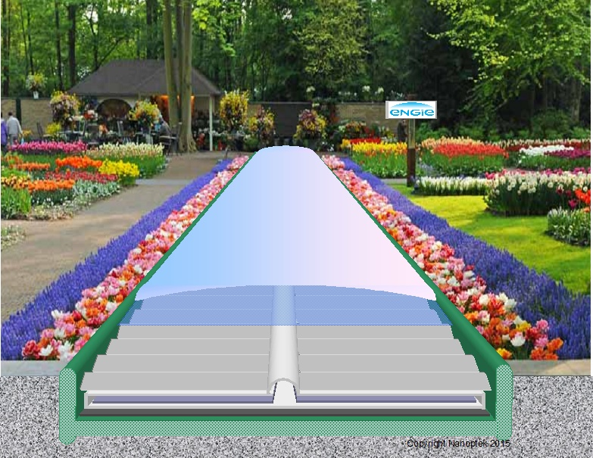
LightFuel® Hydrogen Sunlight to Hydrogen
SeaFern™
form factor
Thank you!
We look forward to discussing your opportunities for Joint Venture and/or Investment
in Green Hydrogen.
Hydrogen from Sunlight for Storage, Mobility, and More….
2020-2-02 LightFuel Solar-Amplified Electrolysis Copyright 2020 LightFuel Co.

